Slide 1
5th Annual Community Day Health and Wellness Fair
Outcomes Report

Slide 2
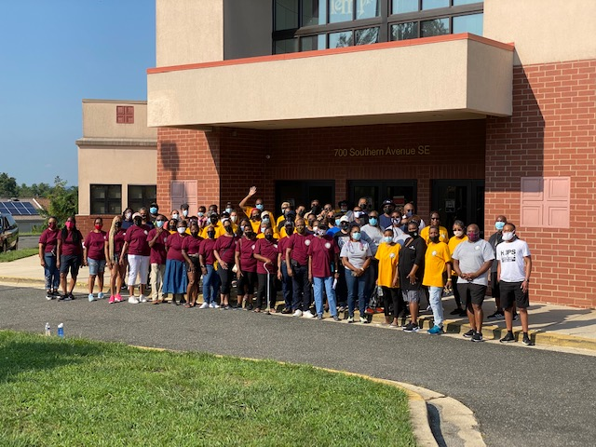
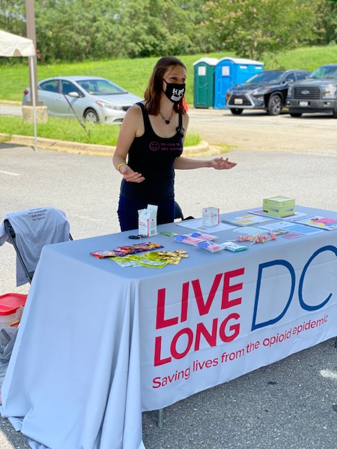
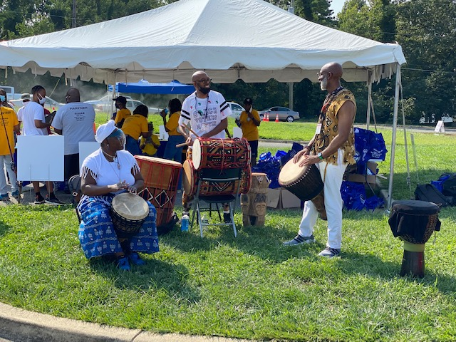
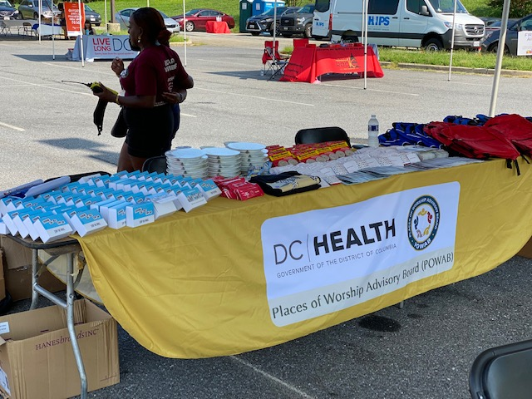
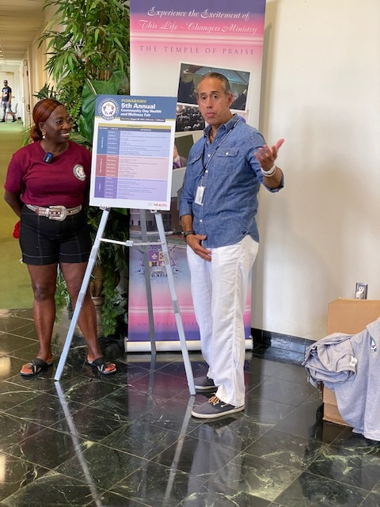
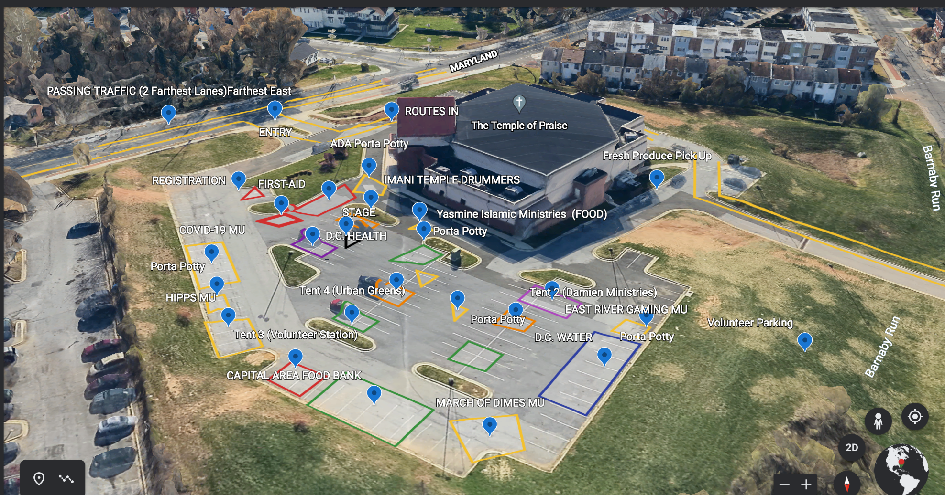
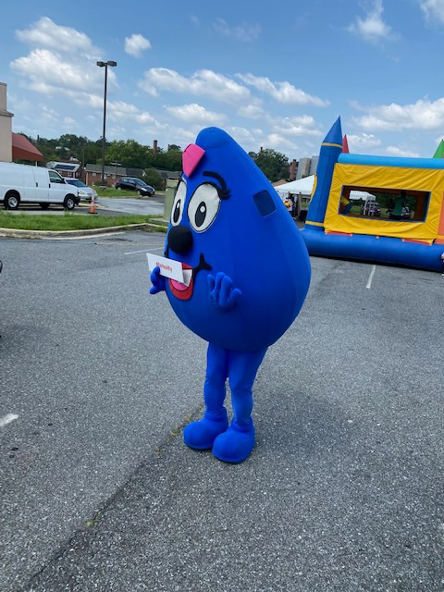
POWAB Health & Wellness Fair

Slide 3
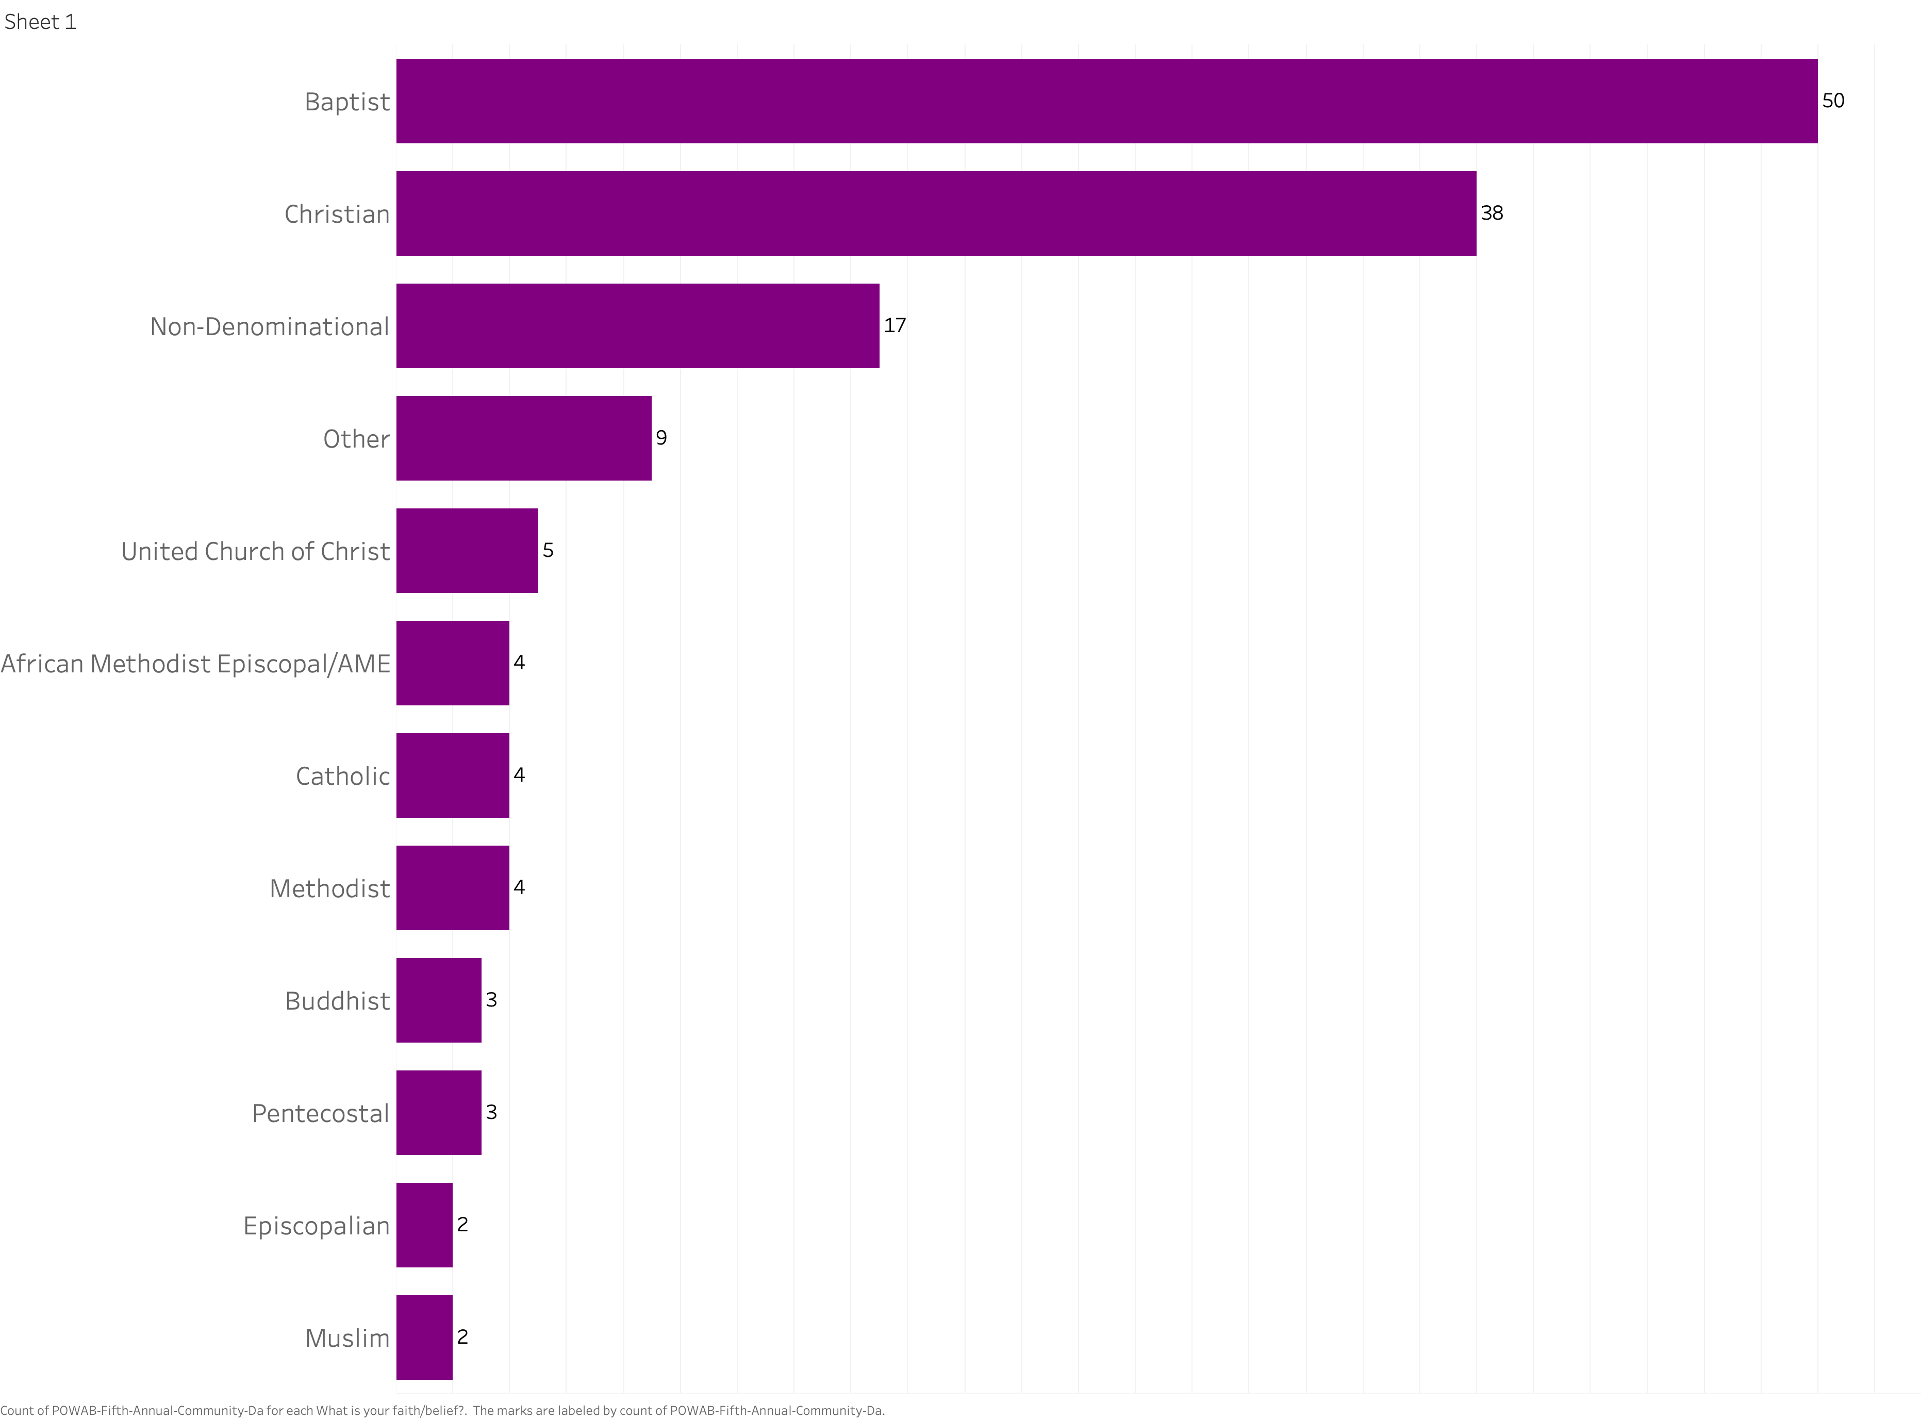
Faith/Belief of Participants
Baptist (34%)
Christian (25%)
Non-Denominational (11%)

Slide 4
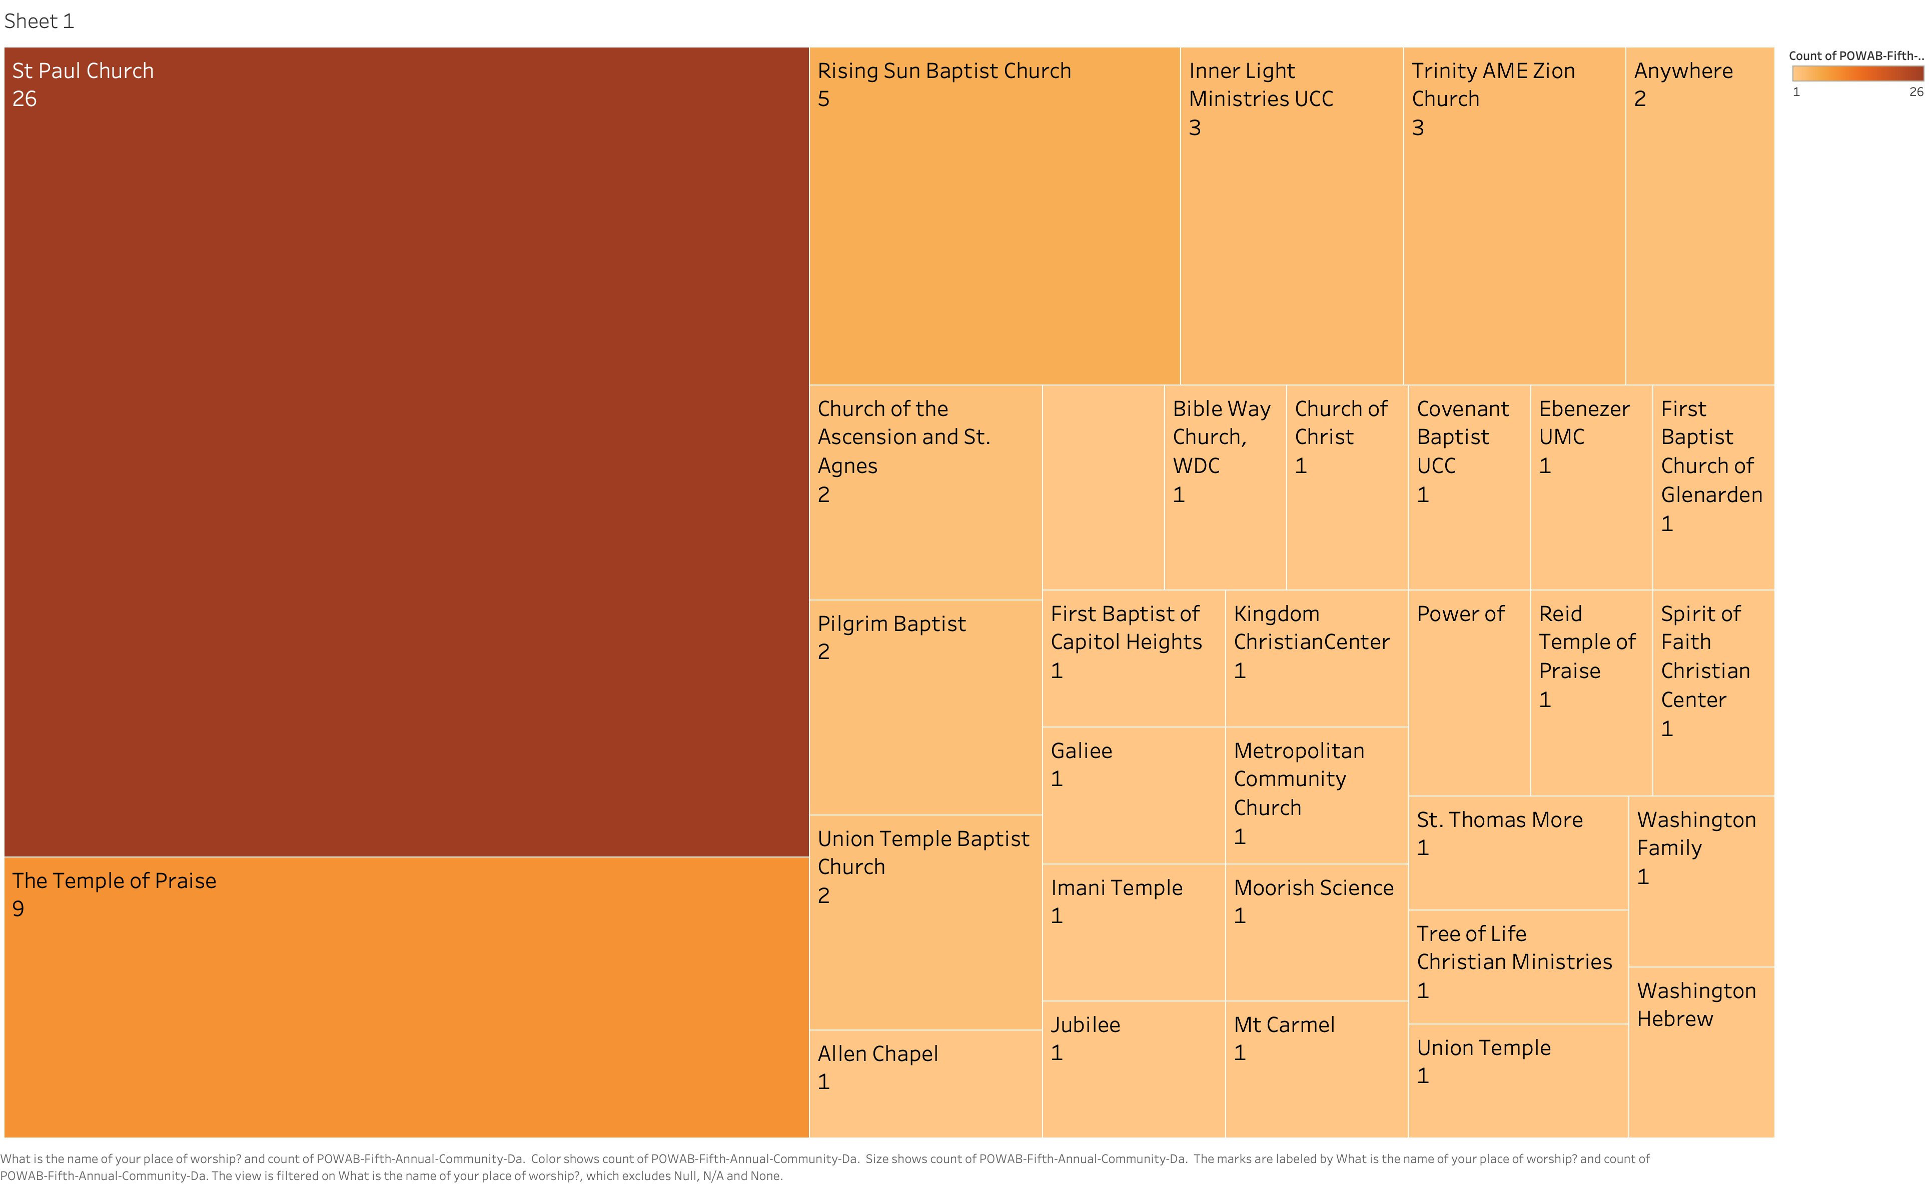
Places of Worship

Slide 5
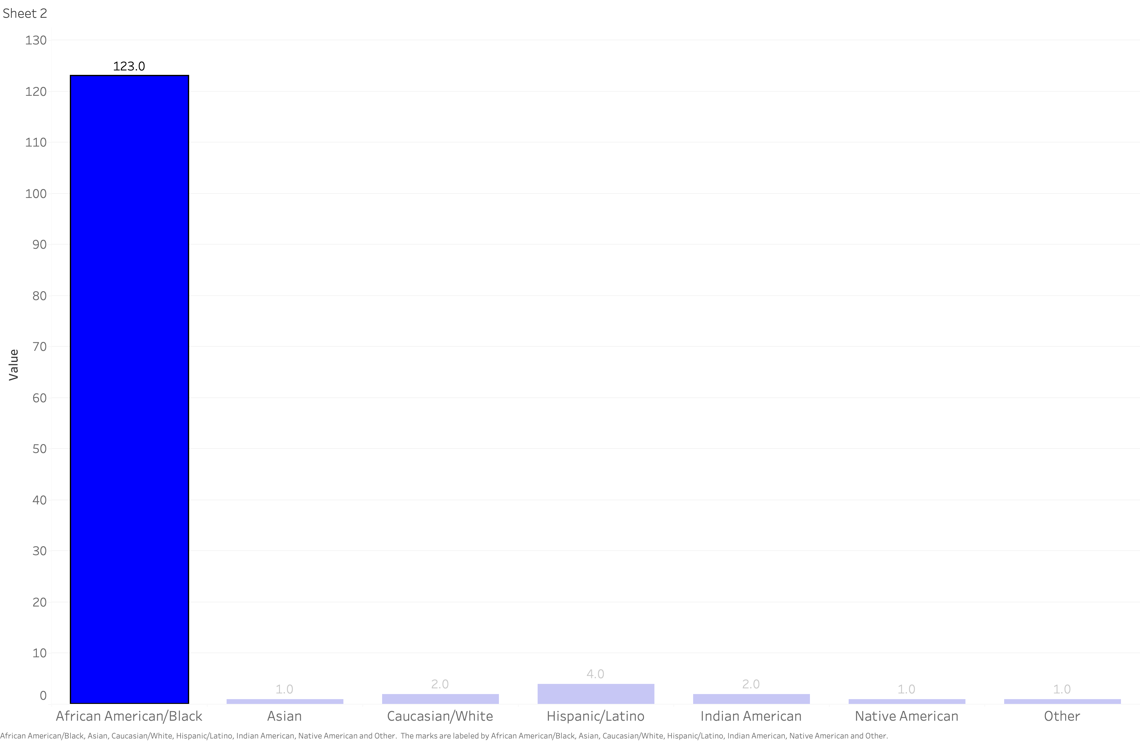
Race/Ethnicity of Participants
82% African American/Black
3% Hispanic/Latino

Slide 6
Sex/Gender of Participants
Female (100)
Gender Non-Conforming (2)
Male (46 )
Transgender Female (3)

Slide 7
Food Items Distributed Provided
555 Lunches
380 Fresh Produce Bags
25 Seniors reach with fresh produce and event bags
700 Bottles of water
30 Breakfasts
500- Fresh Fish Lunches

Slide 8
Services Provided
32 First AID and Health Screenings
8 Harm reduction trainings
55 Trained in naloxone usage
31 Health insurance education
2 Educated on DC Qualified Medicare Beneficiary program

Slide 9
Items Distributed Provided
5 Safer Sex Kits
268 Naloxone
5 Fentanyl Test Strips
250 T-shirts
2750 Pieces of Health Literature (naloxone, substance use disorder, mental health services)
580 Reusable Shopping Bags
230 Books

Slide 10
Items Distributed Provided
300 Large Sanitizers
300 Disposable Masks
100 Food Measurement Spoons
150 Tupperware Sets
300 Diapers

Slide 11
Donated and Contracted Services
Damien Ministries – Covered Stage (1), Tables (15), Tents (6), Chairs (75), Porta Potties (4)
Good Hope Film/Video Production (Event Photos, Group Photos)
DC Health -- Truck Rental, Sanitation Dispensers (8), Tables, Water Bottles
Devon Anderson -- DJ Services

Slide 12
Email: dc.powab@dc.gov
Visit our Website at: http://www.doh.dc.gov/powab

