Slide 1
Healthy DC Steering Committee
June 28, 2023

Slide 2
DC Health Welcome
HealthyDC 2030 Steering Committee: Meeting 2
Welcome to DC Health:
Mr. Keith A. M. Fletcher, Interim Director, DC Health
Co-Convenor:
Mr. Wayne Turnage, Deputy Mayor Health & Human Services
Co-Convenor:
Dr. C. Anneta Arno, Director, Office of Health Equity
Healthy People Manager:
Ms. Emily Putzer, MA, Center for Policy Planning & Evaluation

Slide 3
Agenda:
Welcome & Introductions
Part 1: Quick Refresh
Healthy DC 2030 Development Process
Part 2: Cross-Cutting Measures and Data Update
Part 3: Developing Priorities for Healthy DC 2030
Part 4: Discussion
Q & A
Part 5: Next Steps
Future Meetings - Proposed
Public Comment
Adjourn

Slide 4
Self-Introductions
Thanks to each of you who have taken the time to join us today!
- Please take a moment to type your name and organization.

Slide 5
Quick Refresh
Why
Healthy DC 2030 Development Process

Slide 6
Community Health Improvement Process
Background
A cycle that works collaboratively across sectors to assess community health; develop goals, objectives, and targets; and recommend strategies that will improve population health.
Notes:
Emily

Slide 7
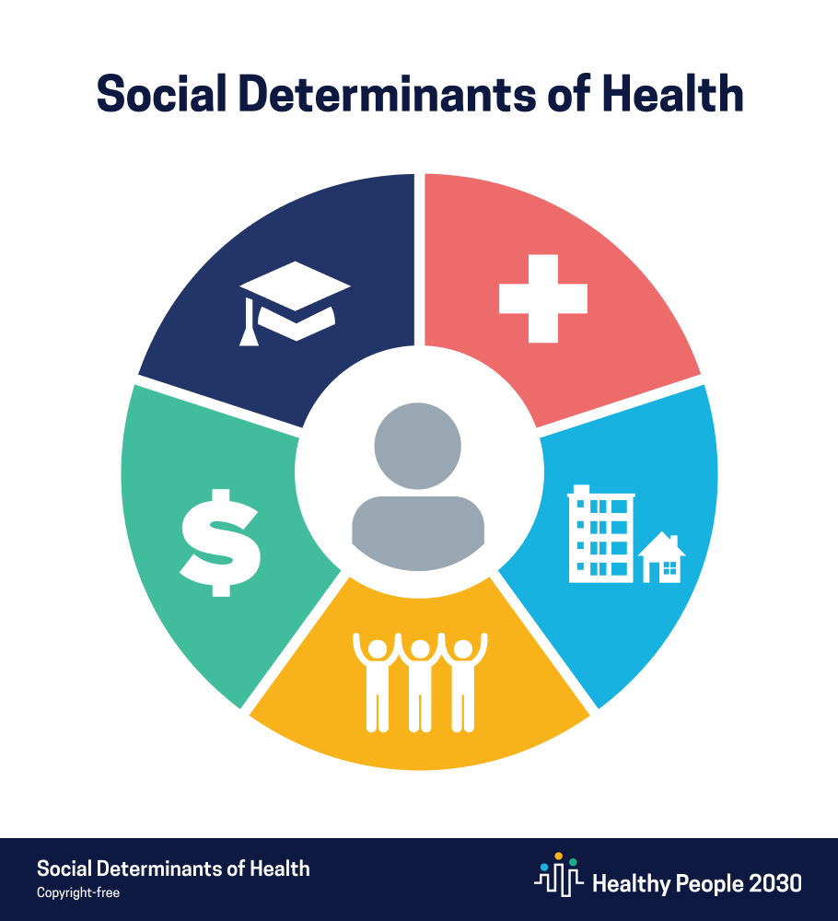
Healthy People 2030: Social Determinants of Health
Economic Stability
Education Access & Quality
Health Care Access & Quality
Neighborhood & Built Environment
Social & Community Context
Notes:
Emily

Slide 8
Healthy DC Planning Anchors
Equity as a Central Tenet
Explicitly Naming and Employing an Anti-Racist Lens
Leveraging an engaged Whole-of-Community and Health-in-all-policies (HiAP) Approach -- to drive Practice Change
Focused on Post-Pandemic Context
Informed by demonstrated pandemic learning & momentum
Alignment with National Healthy People 2030
Notes:
Emily

Slide 9
Healthy DC 2030 Methodology
Modified Results-Based Accountability
What do we want? (Results/Goals)
How will we recognize it? (Objectives, Targets)
What will it take to get there? (Strategies)
Facilitated, data-driven process
Start with ends and work backward to means.
Use data to drive decisions, not just measure success or failure after the fact.
Results are desired conditions of well-being, the ends we want, for children, adults families and communities
www.raguide.org
Notes:
Emily

Slide 10
Healthy DC 2030 Components
Functional Process Areas
Five groupings of Topic Areas that include:
Health Conditions
Social/Structural Determinants of Health
Health Behaviors
Populations
Settings and Systems
Topic Areas
32 disease-, population- or system-related groups that organize the subsequent components within each Topic Area.
Priority Topic Areas: a sub-set of topic areas that have been prioritized by the community and stakeholders.
Goals
A set of 1-3 overarching goal statements describing the ideal state related to each Topic Area (aspirational).
Notes:
Emily

Slide 11
Healthy DC 2030 Components (cont.)
Objectives
A set of measurable indicators that have been determined to best measure if we have achieved our Goals for each Topic Area.
Leading Health Indicators: a sub-set of objectives that have been prioritized by the community and stakeholders.
Targets
Proposed targets to reach by 2030.
Strategies
High-level strategies to tackle one or more of the identified objectives and goals within a topic area.
Notes:
Emily

Slide 12
Stakeholder Engagement Summary
Workgroup Process – Launched May 2022
GOAL: Engage multi-sector stakeholders to collaboratively develop goals, objectives, and targets and recommend strategies for the Healthy DC 2030 framework.
Steering Committee – Launched March 2023
GOAL: Engage a leadership forum representing public-private partnerships along the nine key drivers of health to guide and champion progress on implementation and outcomes for collective impact.
Community Engagement - Ongoing
GOAL: Develop mechanisms whereby residents are continuously and meaningfully engaged in all aspects of the Healthy DC 2030 development process, including implementation and monitoring/evaluation.
Notes:
Emily
Community engagement includes community surveys, social media outreach, etc.

Slide 13
HEALTHY DC 2030: Coalition Structure & Process

Slide 14
DC Healthy People 2020 Priorities (2020 Action Plan)
Annual Report & Action Plan: 2017 to 2019
In 2016, the DC Healthy People 2020 (DC HP2020) Framework was released as our shared community health improvement agenda. Through the DC HP2020 development process, a multi-sector collaborative prioritized health outcome objectives and recommended evidence-based strategies to achieve the biggest population health impact. It is our hope that stakeholders and community members will use the DC HP2020 Framework and this Annual Report and Action Plan to:
• Support shared goals to achieve collective health improvements
• Facilitate continued cross-sector collaboration to implement and support the recommended evidence-based strategies
• Align our work to achieve health equity by addressing the underlying social and structural determinants of health
Notes:
Emily
Source: https://dchealth.dc.gov/sites/default/files/dc/sites/doh/publication/attachments/DOH_AnnualReport_011518_INTERACTIVE%20FINAL%20Reduced.pdf

Slide 15
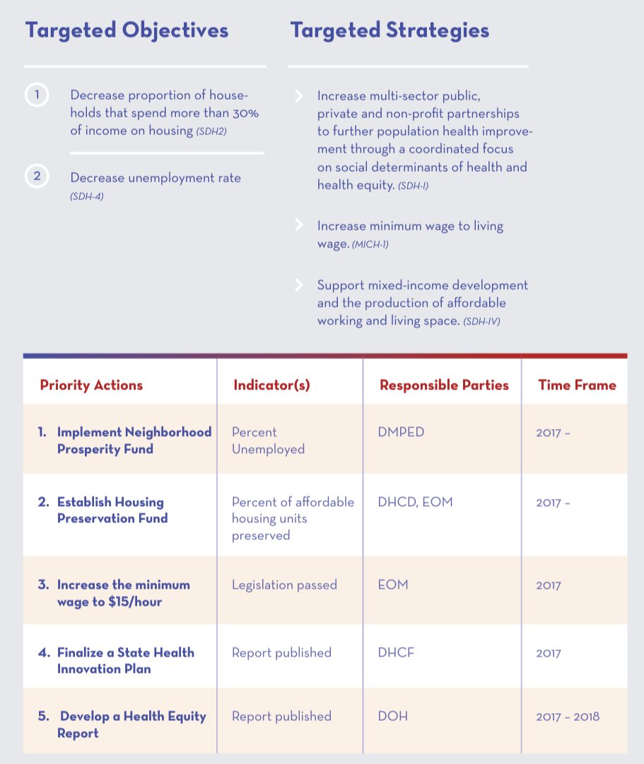
DC Healthy People 2020 Priorities (2020 Action Plan)
Notes:
Emily
Original Action Plan, but there are through-lines that continue in subsequent publications, including the Post-Pandemic Recovery Report, Health Equity Summit, Healthcare Transformation, etc.
Community engagement includes community surveys, social media outreach, etc.

Slide 16
Priority Area 4: Social Determinants of Health

Slide 17
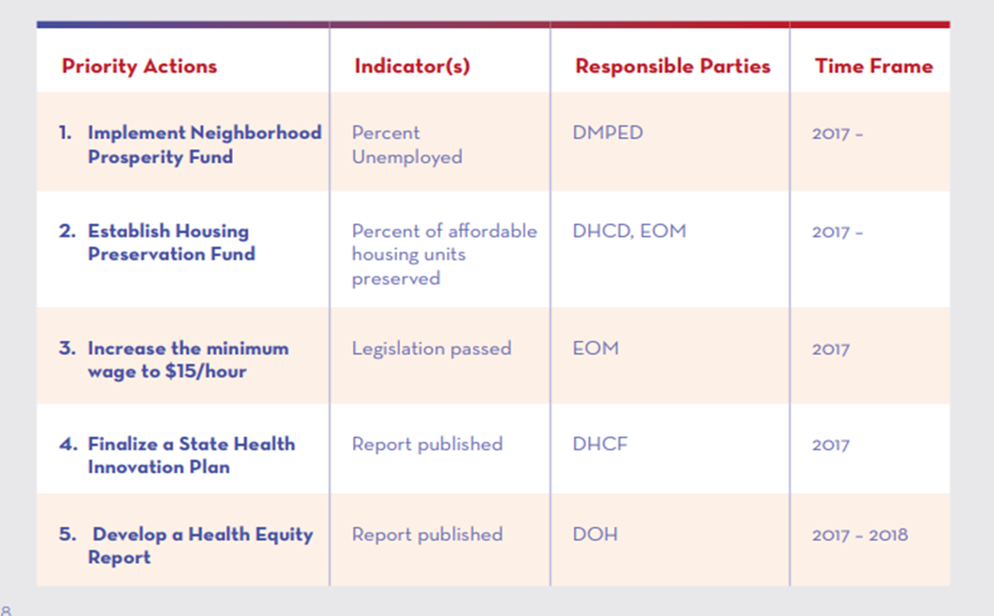
Priority Area 4: Social Determinants of Health

Slide 18
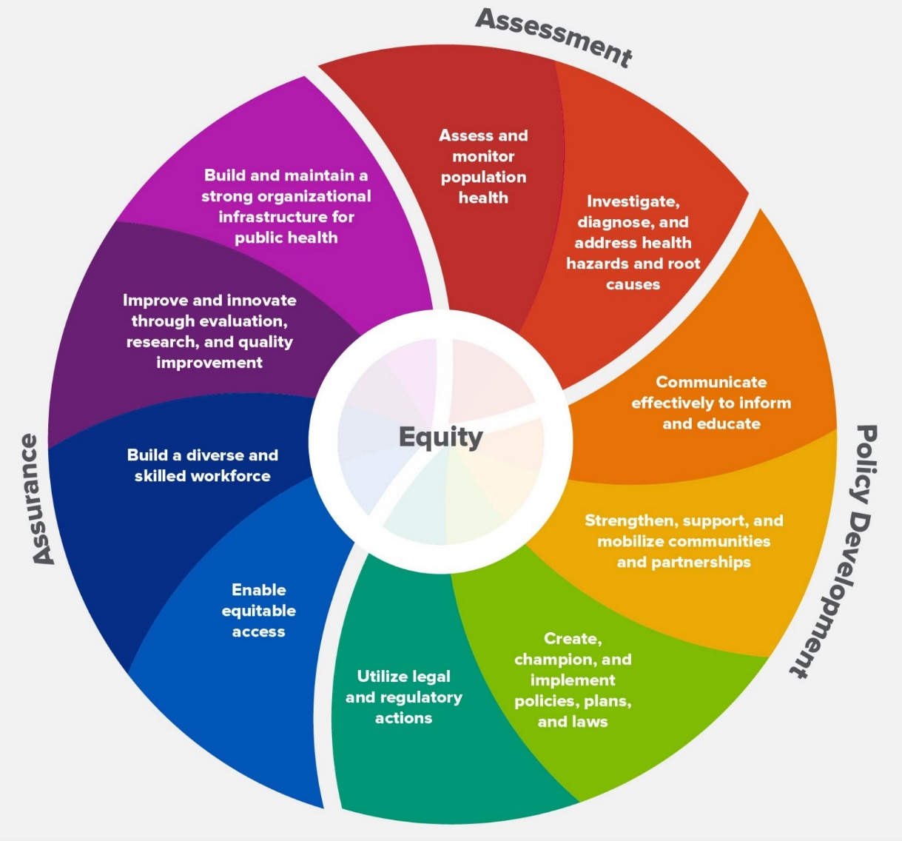
Post-Pandemic Strategic Reframing for Health & Equity
Centering Equity & Applying Equity-informed Lens
Neither Public Health nor Health Care can do it alone
Using A Health Ecosystem Lens
Engaging a strategic whole of community response
Using Healthy People Framework as a Tool
Localizing & Contextualizing for Results
Leveraging Public Health Capabilities as Regulator; Role Model; Convener & Collaborator
10 Essential Public Health Services
DRAFT
Notes:
AA

Slide 19
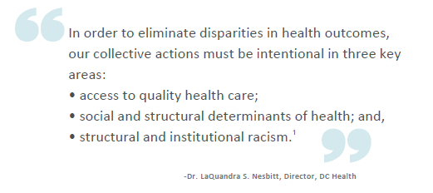
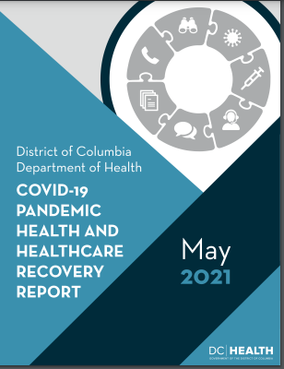
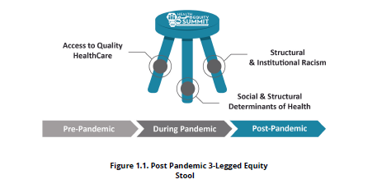
Current & Emerging Priorities
Notes:
AA
Reports that have built on DC Healthy People 2020 Framework and Action Plan Priorities:
HealthCare Transformation Report – Pre-Pandemic
Post-Pandemic Framework – included many "Transformation Recommendations"
Health Equity Summit – 6 recommendations
Mayor's HealthCare Workforce – Report
PH Director's – Public Health Workforce

Slide 20
Cross-Cutting Measures &
Data Update
Healthy DC 2030 Cross-Cutting Measures
Life Expectancy by Neighborhood
Leading Health Indicators

Slide 21
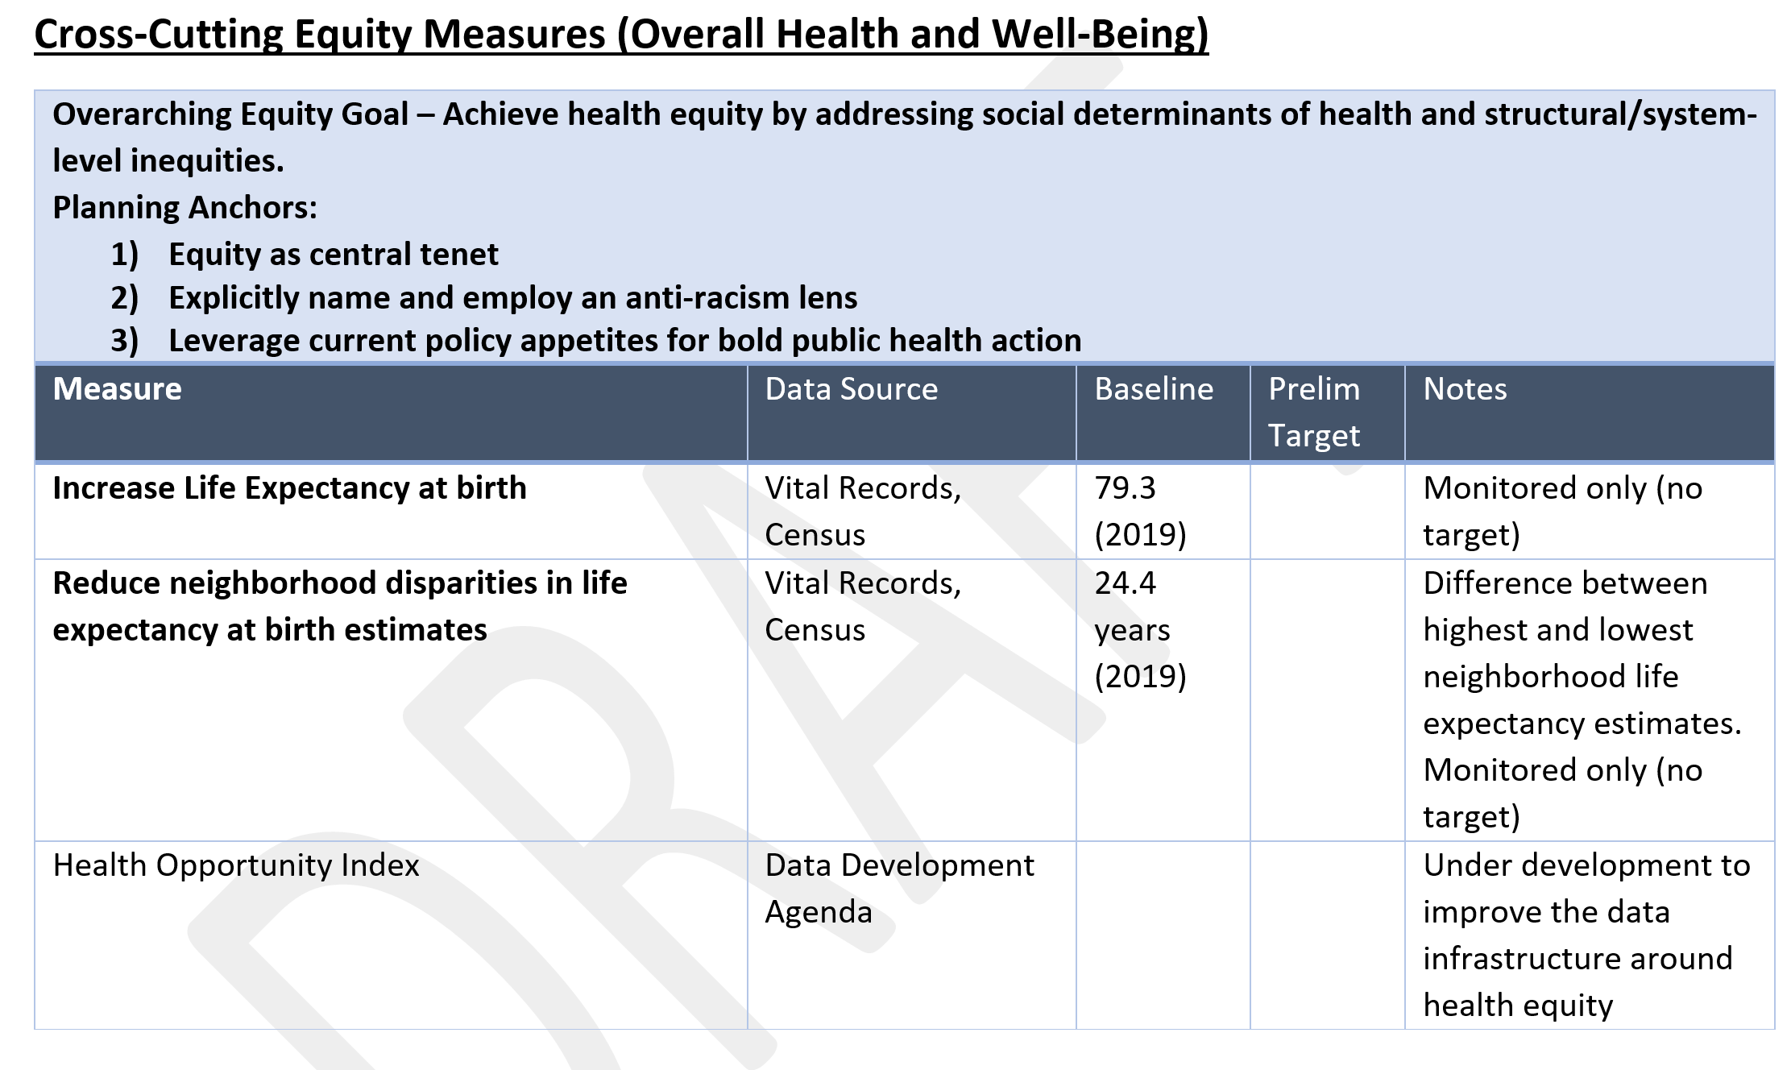
Healthy DC 2030 Cross-Cutting Equity Measures
Notes:
Emily
Community engagement includes community surveys, social media outreach, etc.

Slide 22
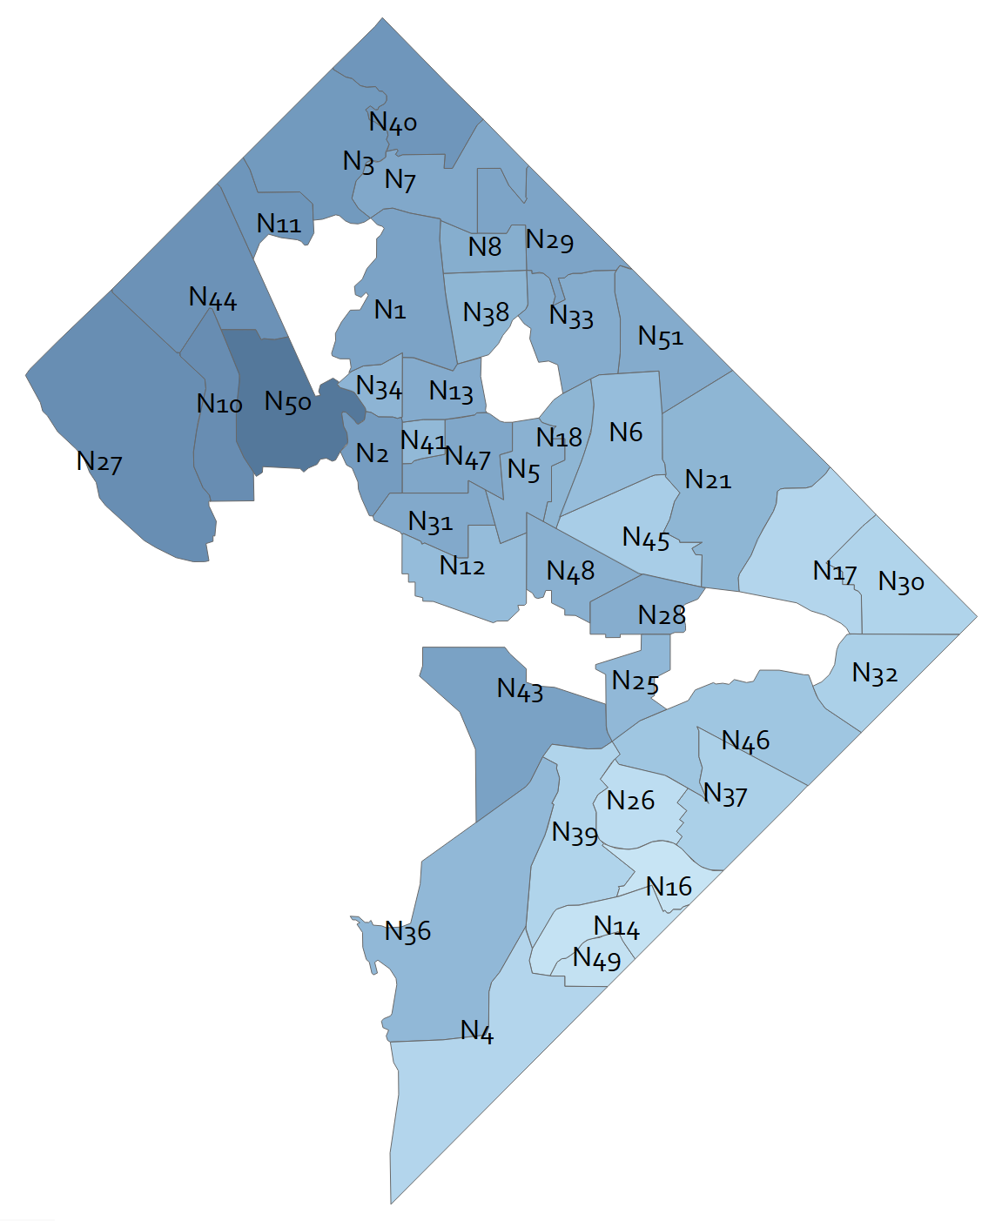
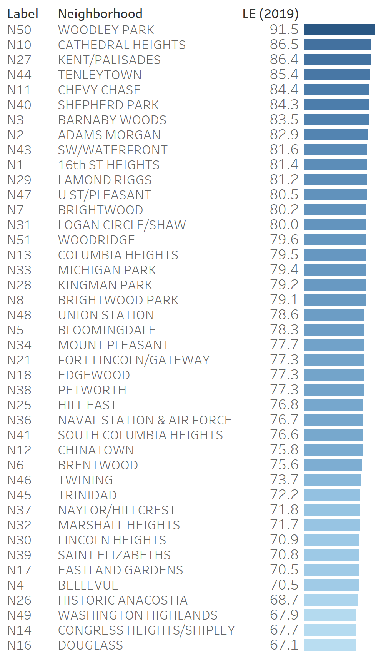
Life Expectancy Estimates by Statistical Neighborhood (2019)
District of Columbia, 2015-2019
*Preliminary Results
Life Expectancy Estimates at Birth
Years of life
DC-Wide
Data Source: Mortality File 2015-2019, Vital Records Division, Center for Policy, Planning and Evaluation, DC Health. American Community Survey 2015-2019, U.S. Census Bureau. Data Note: Standard Errors above 3.0 have been excluded.
Notes:
Dr. Arno

Slide 23
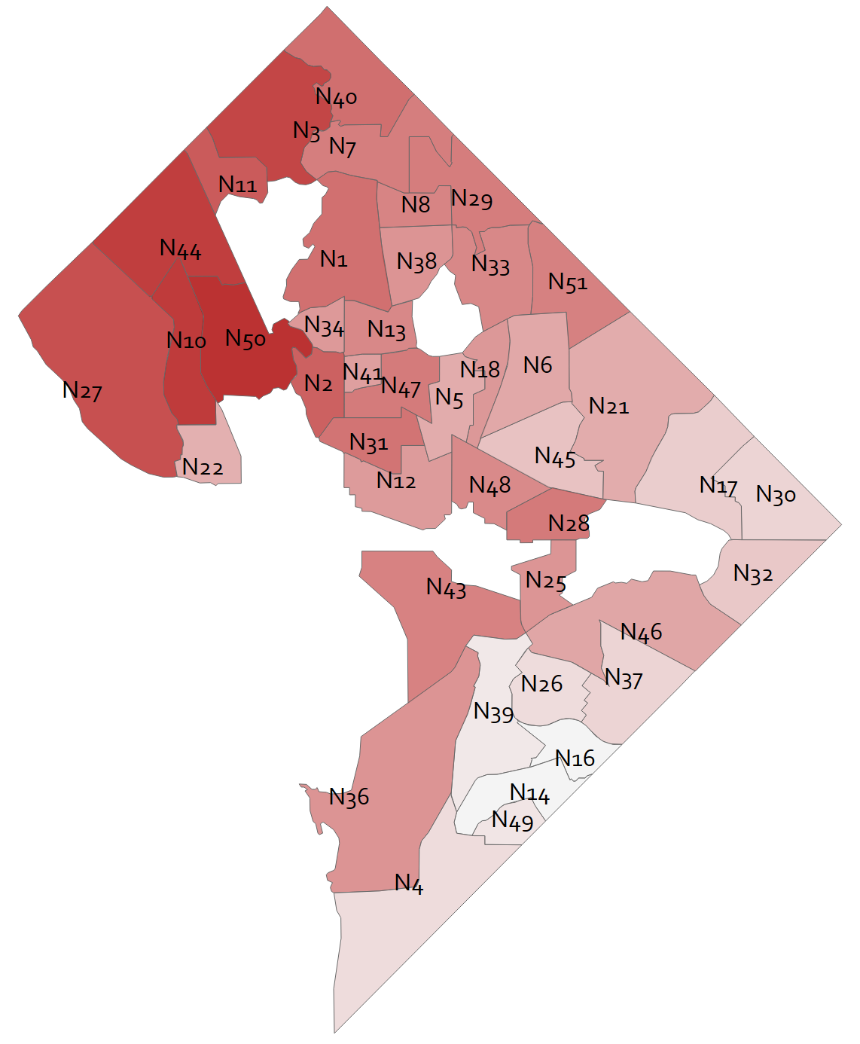
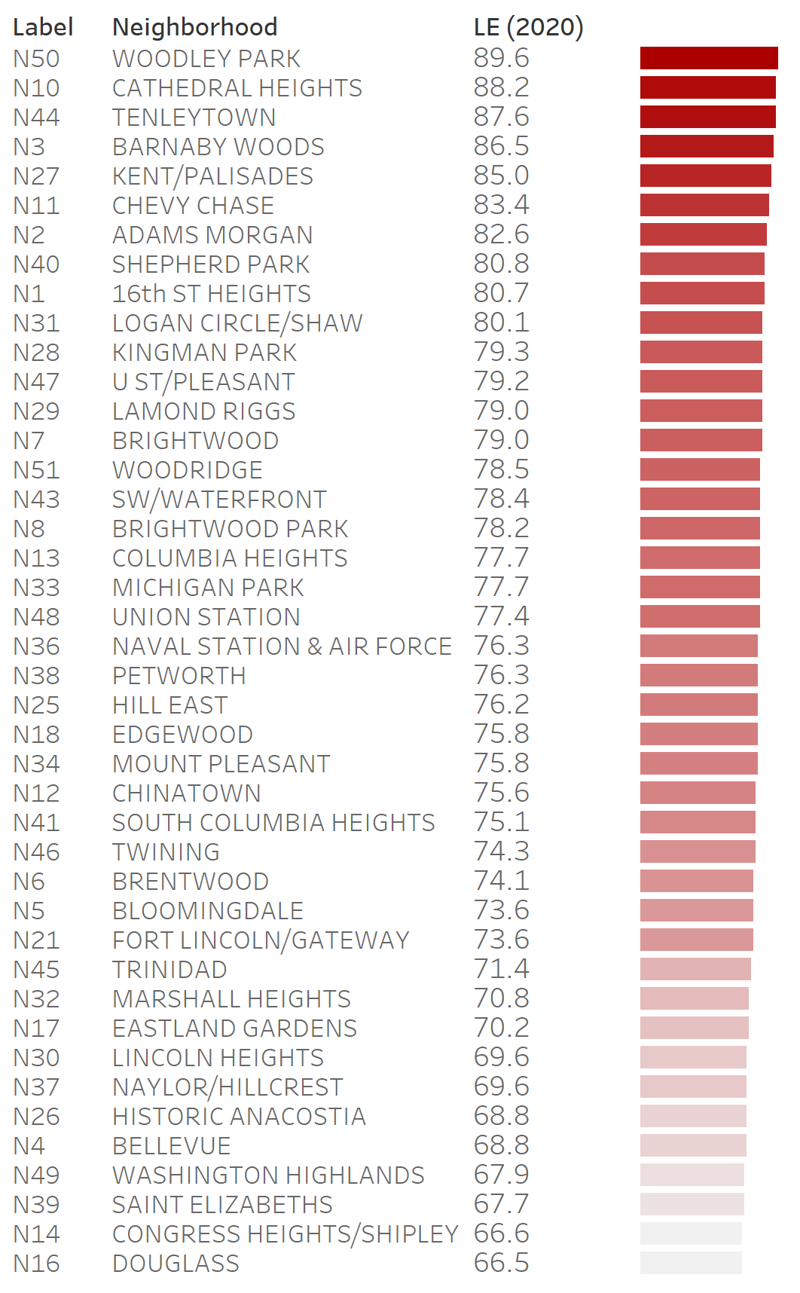
Life Expectancy Estimates by Statistical Neighborhood (2020)
District of Columbia, 2016-2020
*Preliminary Results
DC-Wide
Life Expectancy Estimates at Birth
Years of life
Data Source: Mortality File 2016-2020, Vital Records Division, Center for Policy, Planning and Evaluation, DC Health. American Community Survey 2016-2020, U.S. Census Bureau. Data Note: Standard Errors above 3.0 have been excluded.
Notes:
Dr. Arno

Slide 24
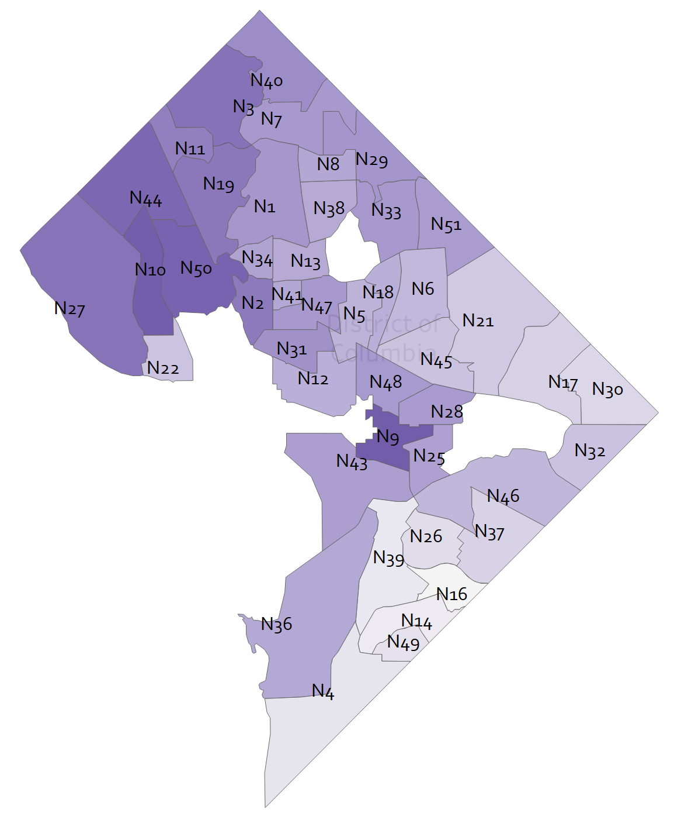
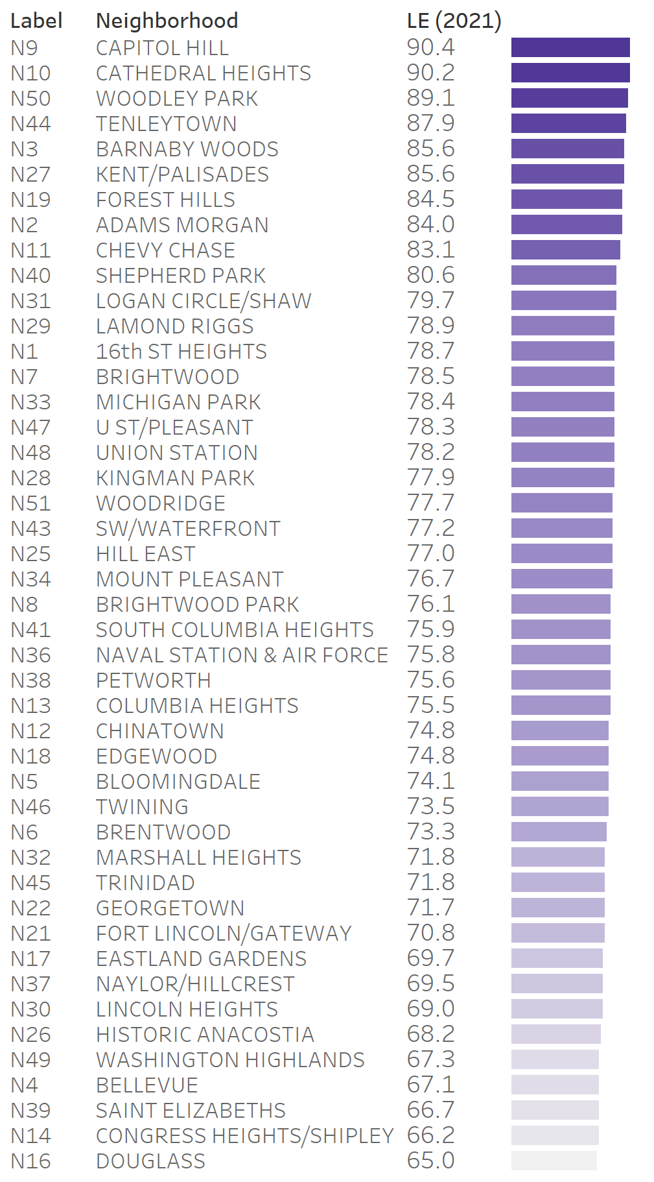
Life Expectancy Estimates by Statistical Neighborhood (2021)
District of Columbia, 2017-2021
*Preliminary Results
Life Expectancy Estimates at Birth
Years of life
DC-Wide
Data Source: Mortality File 2017-2021, Vital Records Division, Center for Policy, Planning and Evaluation, DC Health. American Community Survey 2017-2021, U.S. Census Bureau. Data Note: Standard Errors above 3.0 have been excluded.
Notes:
Dr. Arno

Slide 25
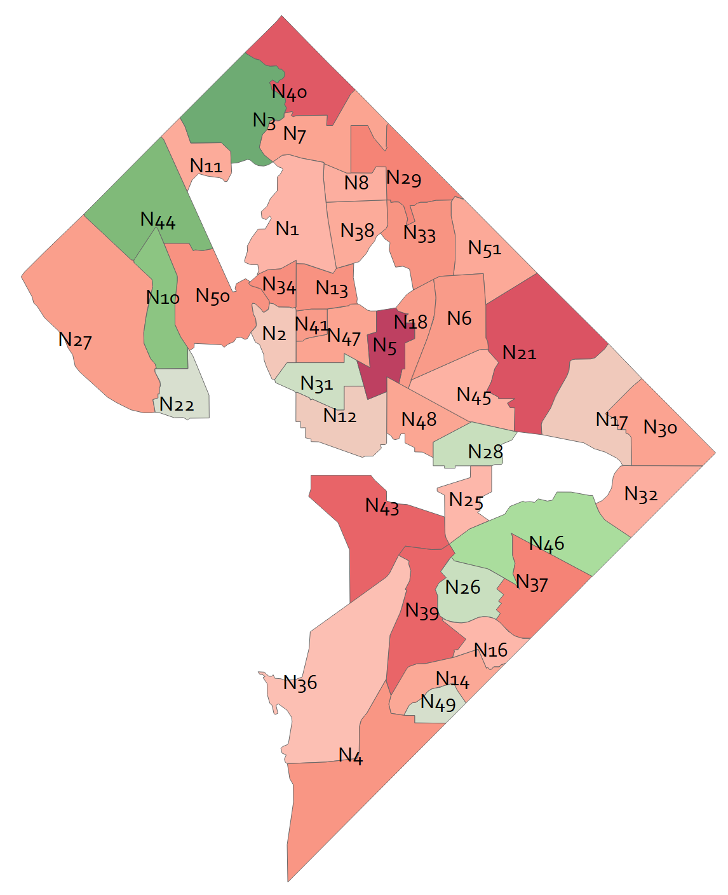
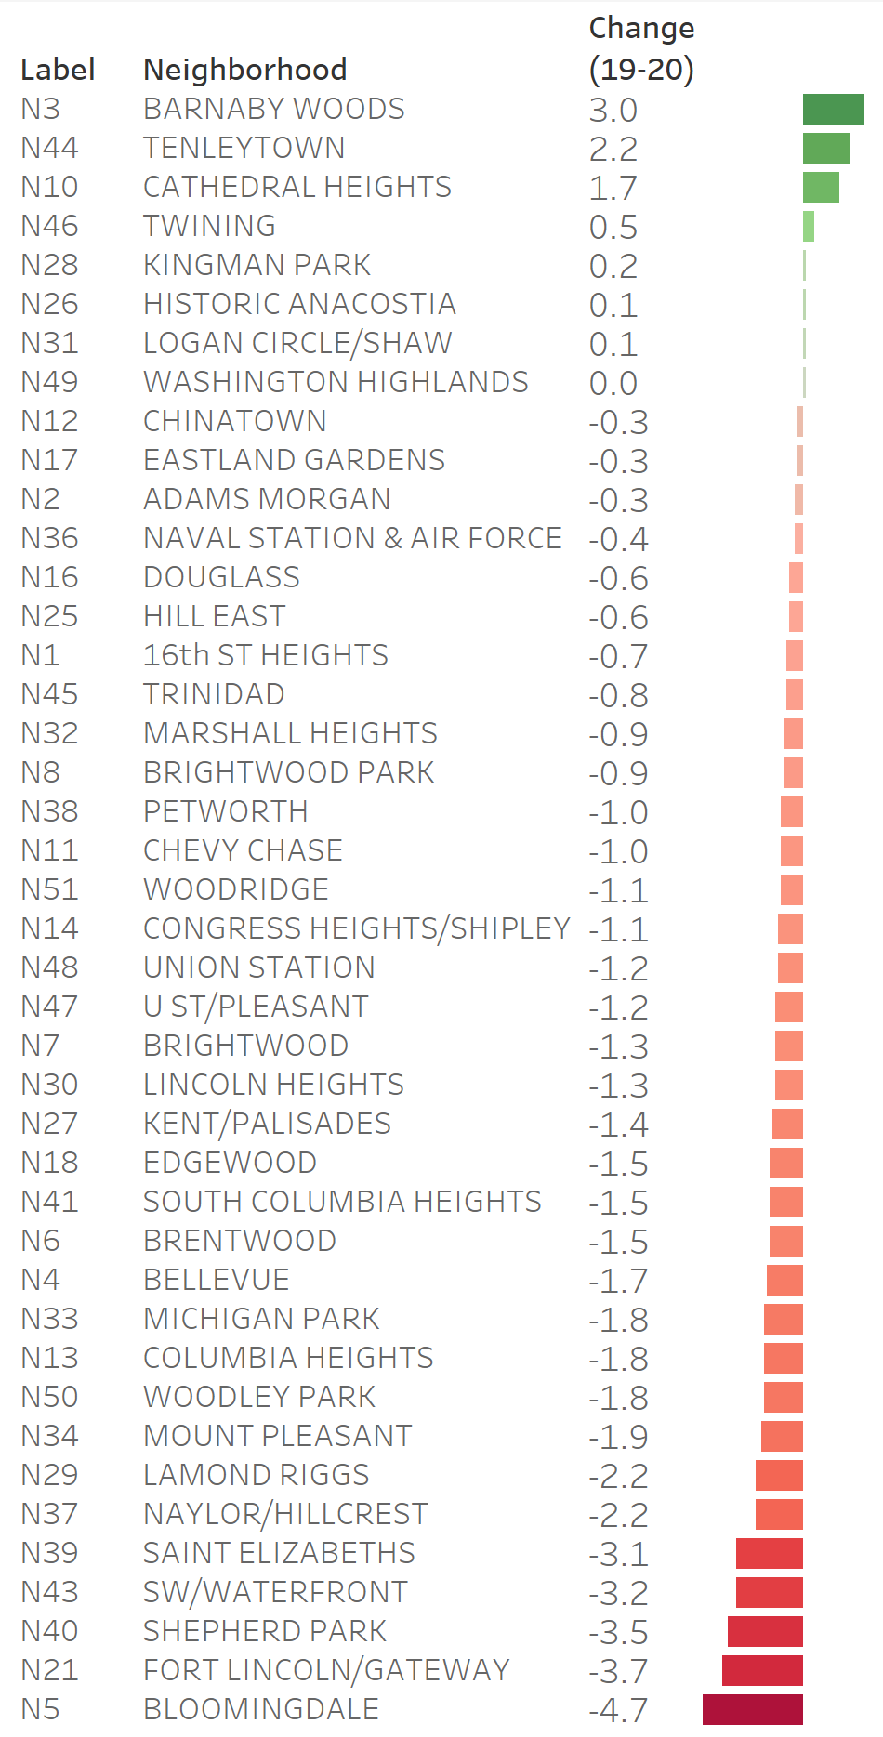
Change in Life Expectancy Estimates by Statistical Neighborhood (2019-2020)
District of Columbia, 2015-2019 compared to 2016-2020
*Preliminary Results
No Change
Change in Life Expectancy Estimates at Birth
Years
Data Source: Mortality File 2015-2020, Vital Records Division, Center for Policy, Planning and Evaluation, DC Health. American Community Survey 2015-2019, 2016-2020, U.S. Census Bureau. Data Note: Standard Errors above 3.0 have been excluded.
Notes:
Dr. Arno

Slide 26
Data Update – 2020 Leading Health Indicators
Status | %
Target Met | 15% (n=3)
Improving | 40% (n=8)
No Difference | 15% (n=3)
Target Missed | 30% (n=6)
Notes:
Emily

Slide 27
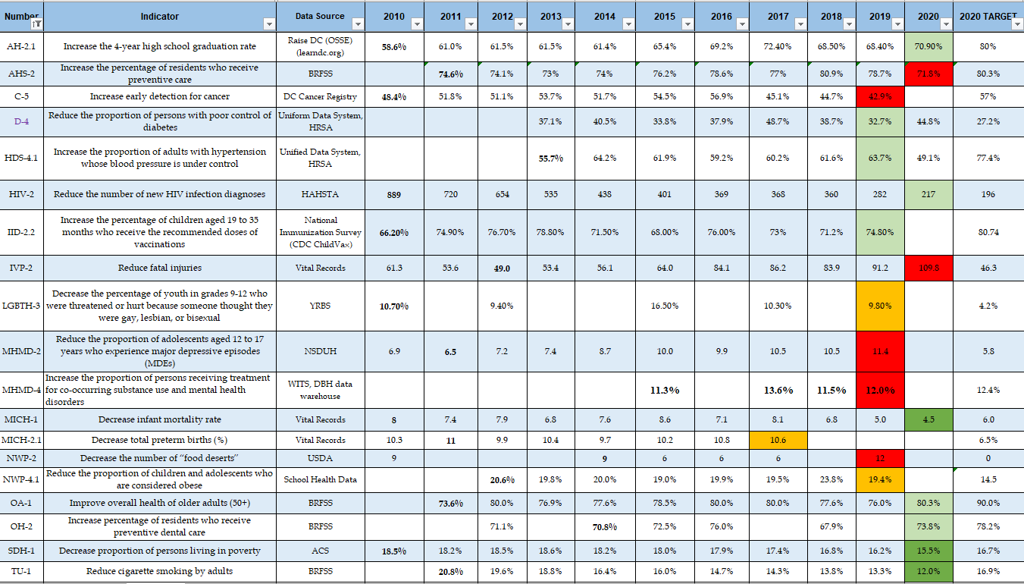
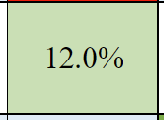
DRAFT
Notes:
Emily

Slide 28
Developing Priorities for Healthy DC 2030
Why

Slide 29
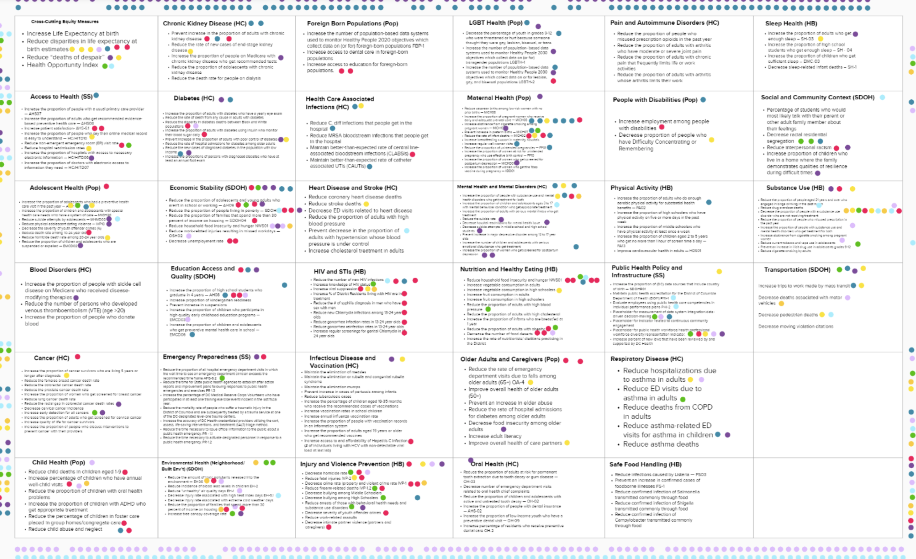
Preliminary Prioritization – Healthy DC 2030
Prioritization Process
Workgroup activity in Mural to prioritize Topic Areas and/or Objectives (November 2022)
Community Surveys
Healthy DC 2030 Priorities – 2021 to present
ReOpen DC Survey (2020)
DC Community Health Needs Assessment Survey (2019)
Notes:
Emily

Slide 30
Preliminary Prioritization – Healthy DC 2030
Preliminary Workgroup Process Results (Top 5)
Injury and Violence Prevention
Economic Stability
Maternal Health
Equity/Cross-Cutting Measures
Substance Use
Preliminary Community Engagement Results (Top 5)
Mental Health and Mental Disorders
Access to Health Services
Substance Use and Addiction
Social Determinants of Health
Nutrition and Healthy Eating
Notes:
Emily

Slide 31
Committee Q&A
Notes:
Dr. Arno

Slide 32
Public Q&A

Slide 33
Next Steps
Review and refine alignment of Healthy DC 2030 strategies and objectives with organizational, sectoral and city-wide priorities
Prioritize topic areas and develop collective Action Plan
Notes:
???

Slide 34
Healthy DC 2030 Steering Committee Launch
Quarterly Meetings & Proposed Agenda
1st Convening
Process Intro & Overview
MARCH 2023
JUNE 2023
2nd Convening
Priorities & Strategies
3rd Convening
Framework Adoption
SEPTEMBER 2023
DECEMBER 2023
4th Convening
Action Plan

Slide 35
Healthy DC 2030 Steering Committee 2023
Future Meetings - Proposed
Today June 2023
June 28th 2023
Confirmed:
September 2023 – 4th Wednesday
September 27th , 2023
December 2023 – 2nd Wednesday
December 13th, 2023

